Slide 1

Flight Ticket Prediction – Case of Indian Airlines
By marissa rahmania

Slide 2
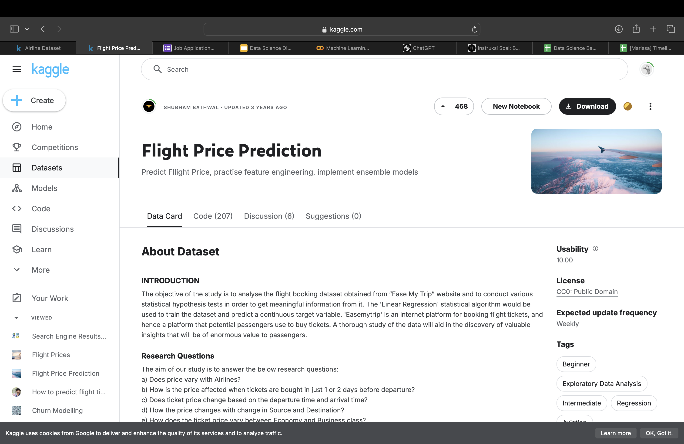
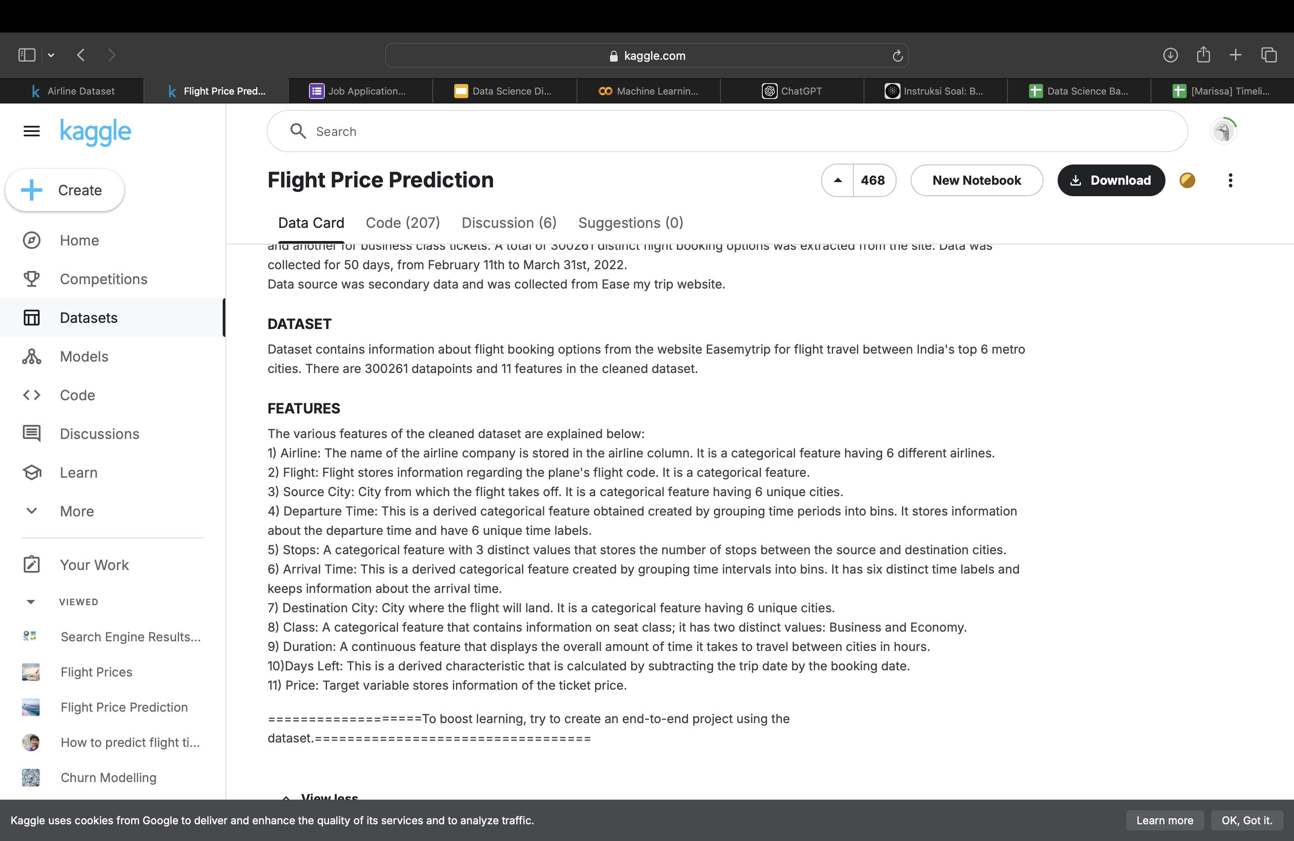
Dataset

Slide 3
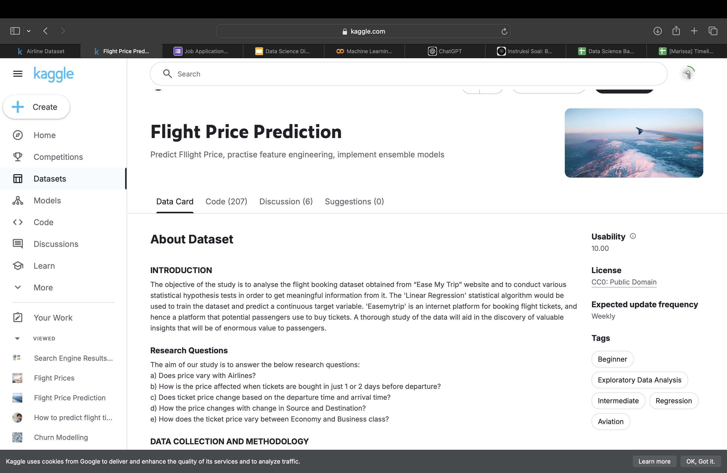
Data Understanding

Slide 4
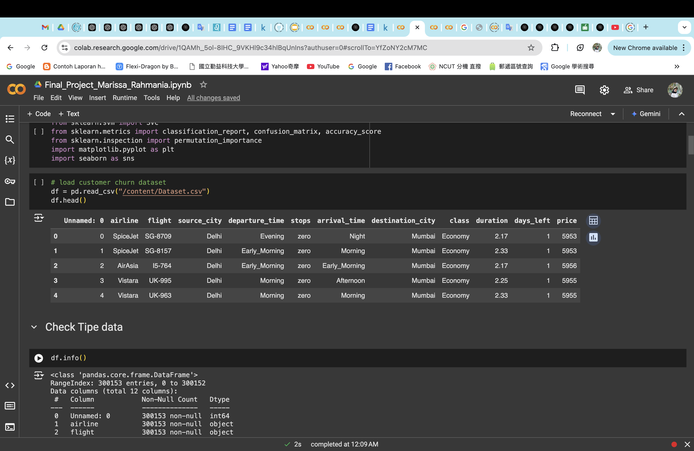
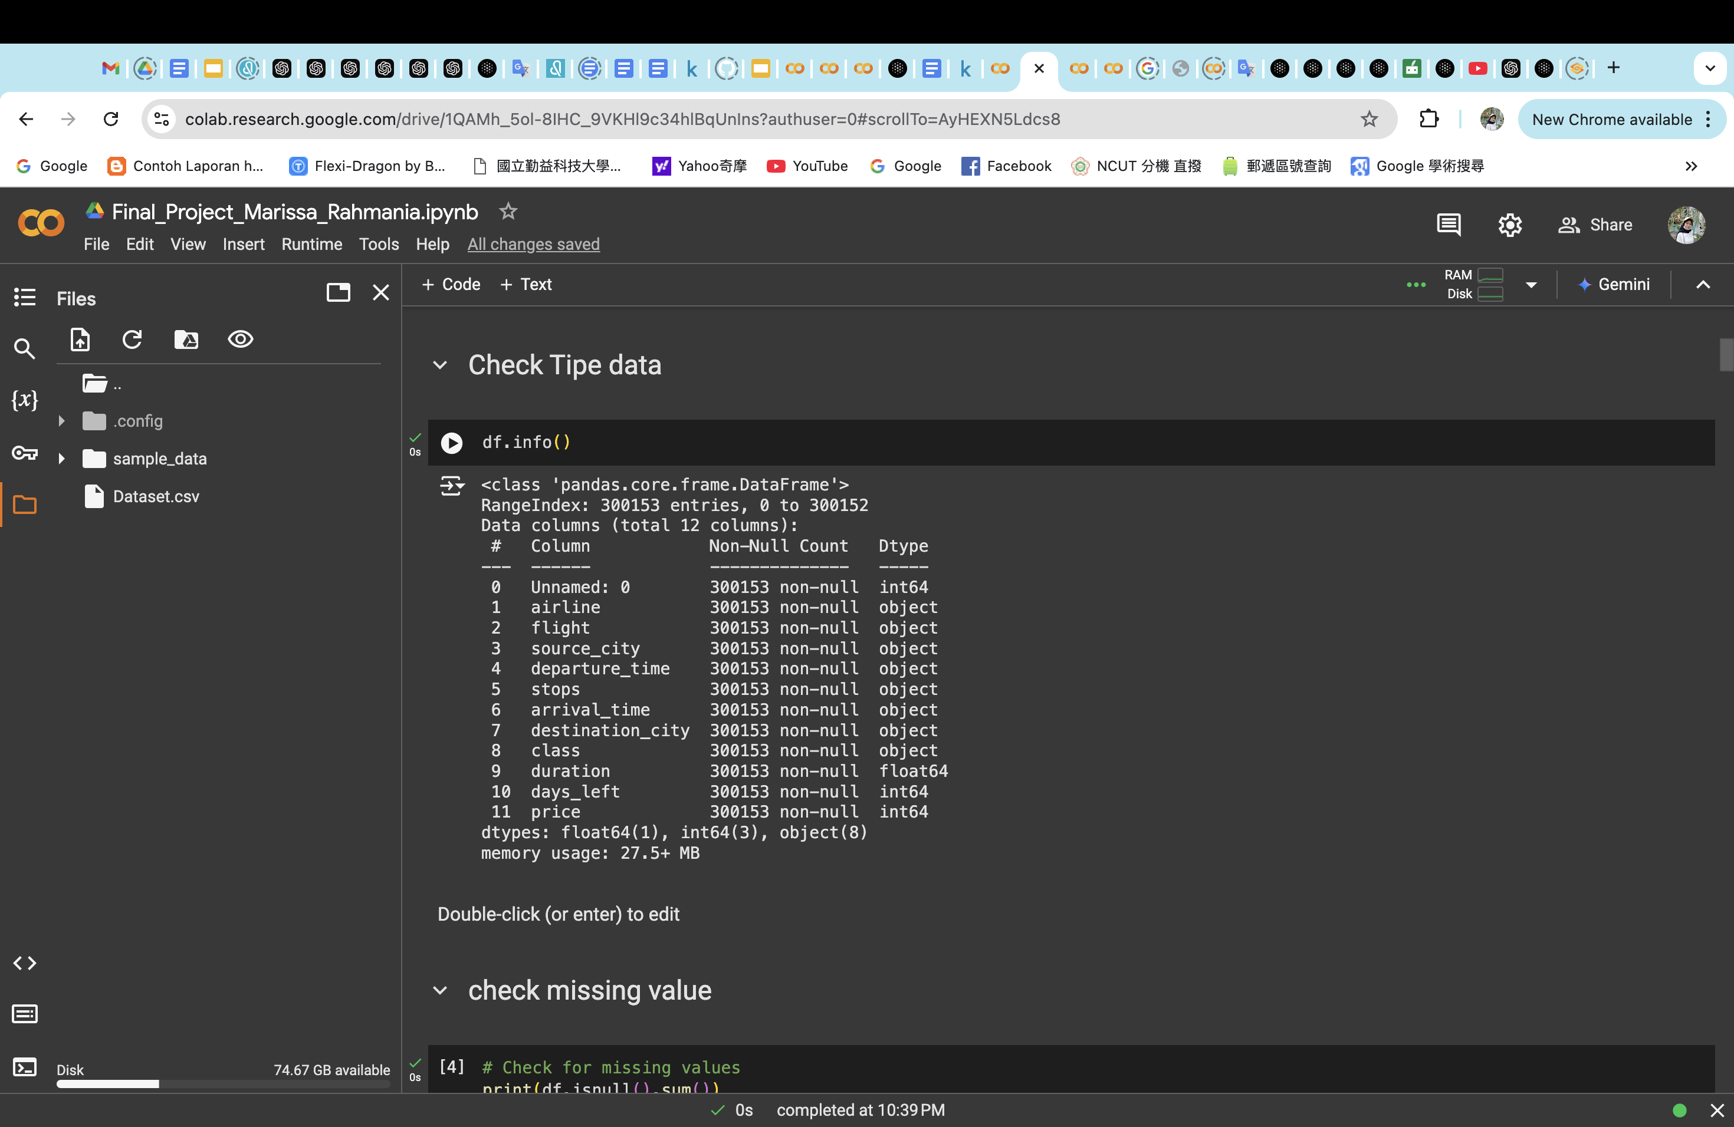
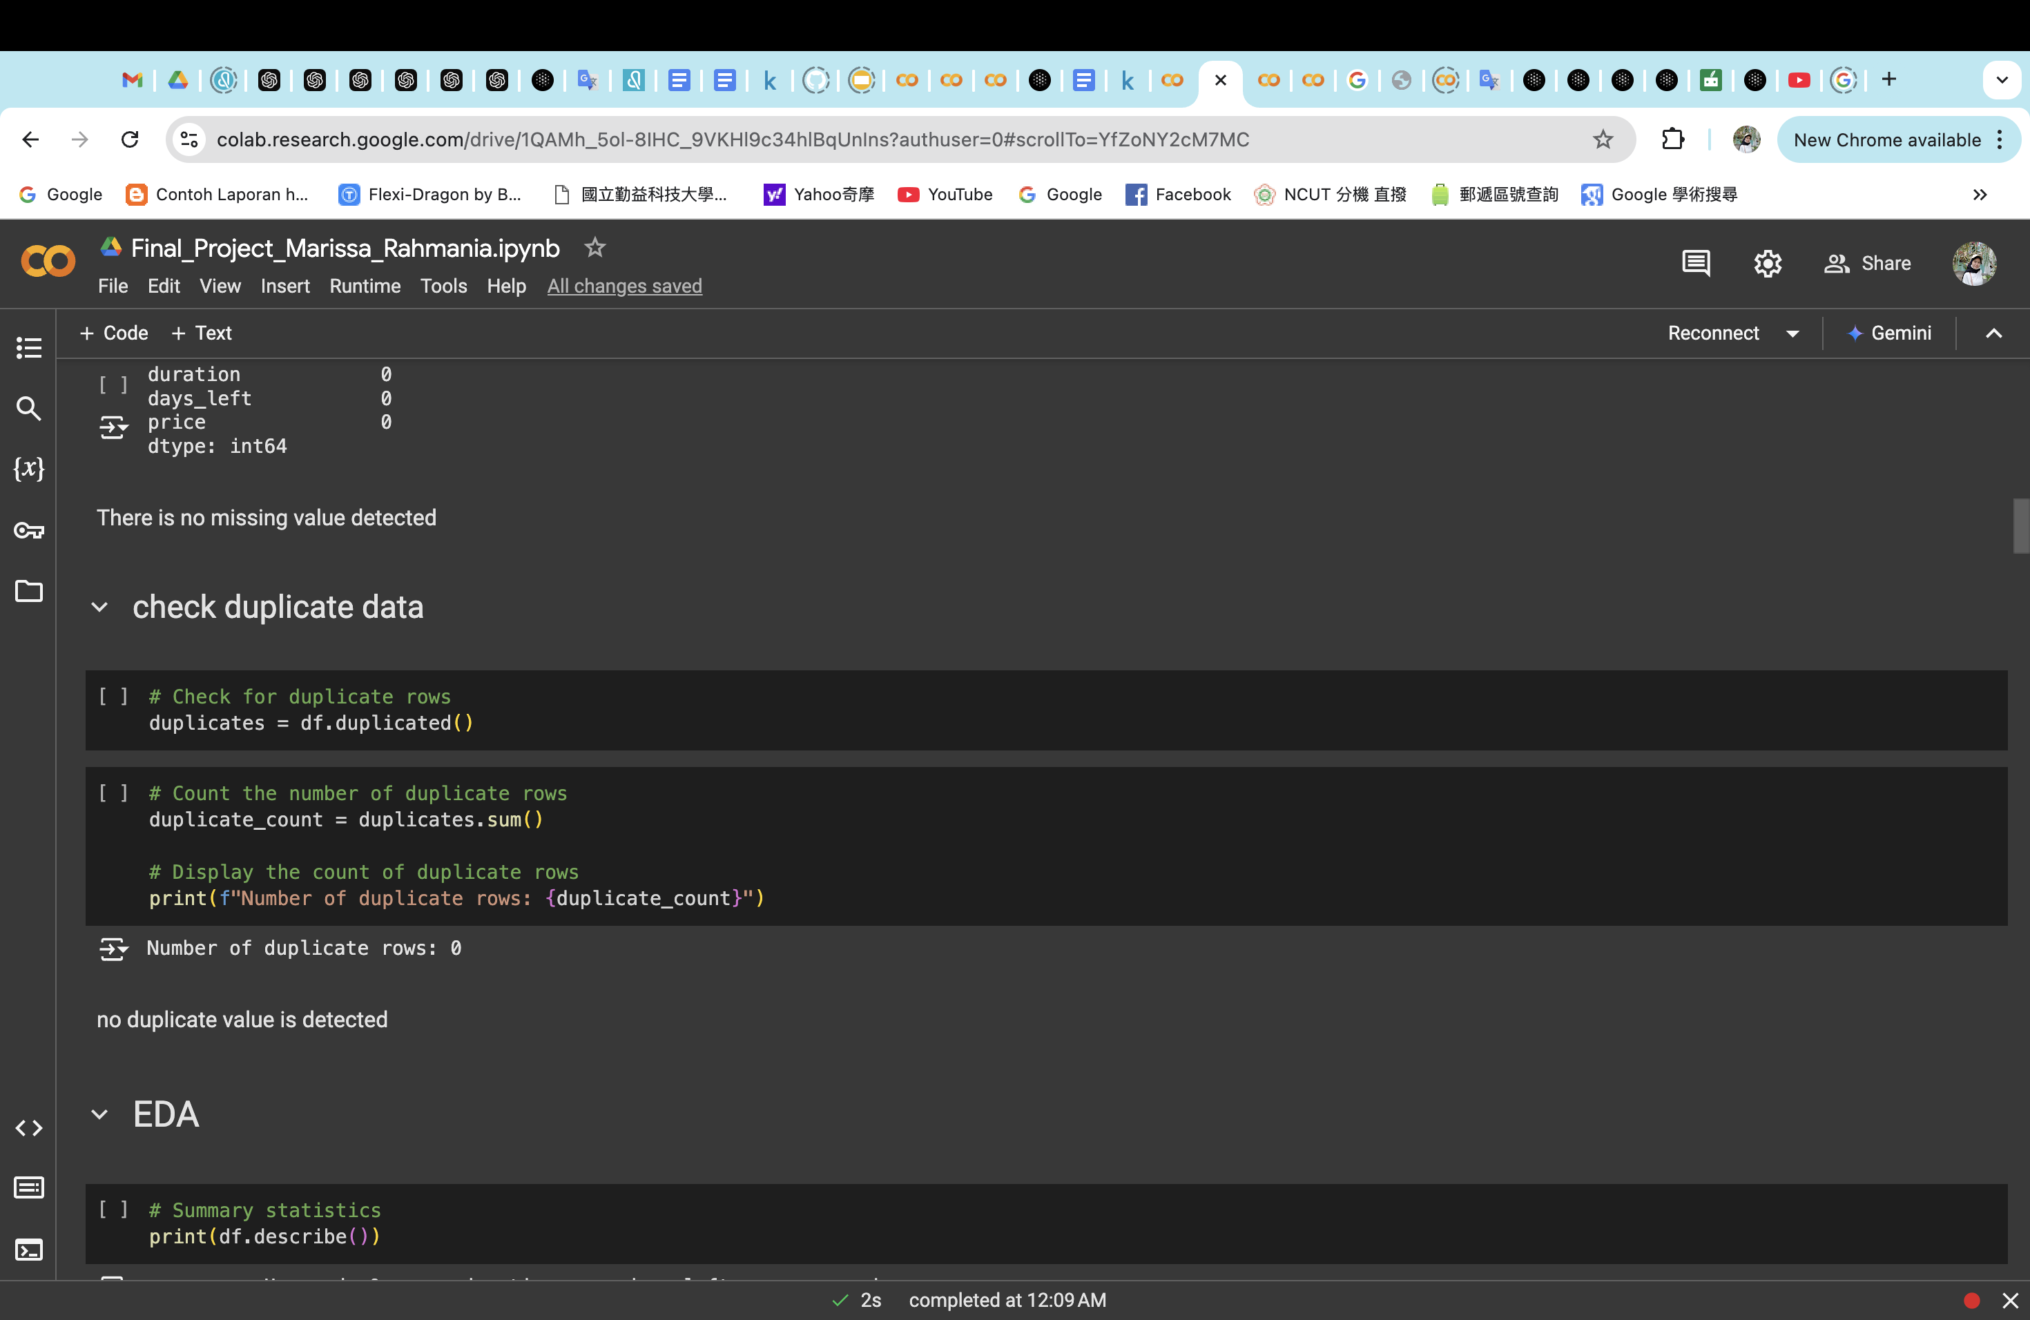
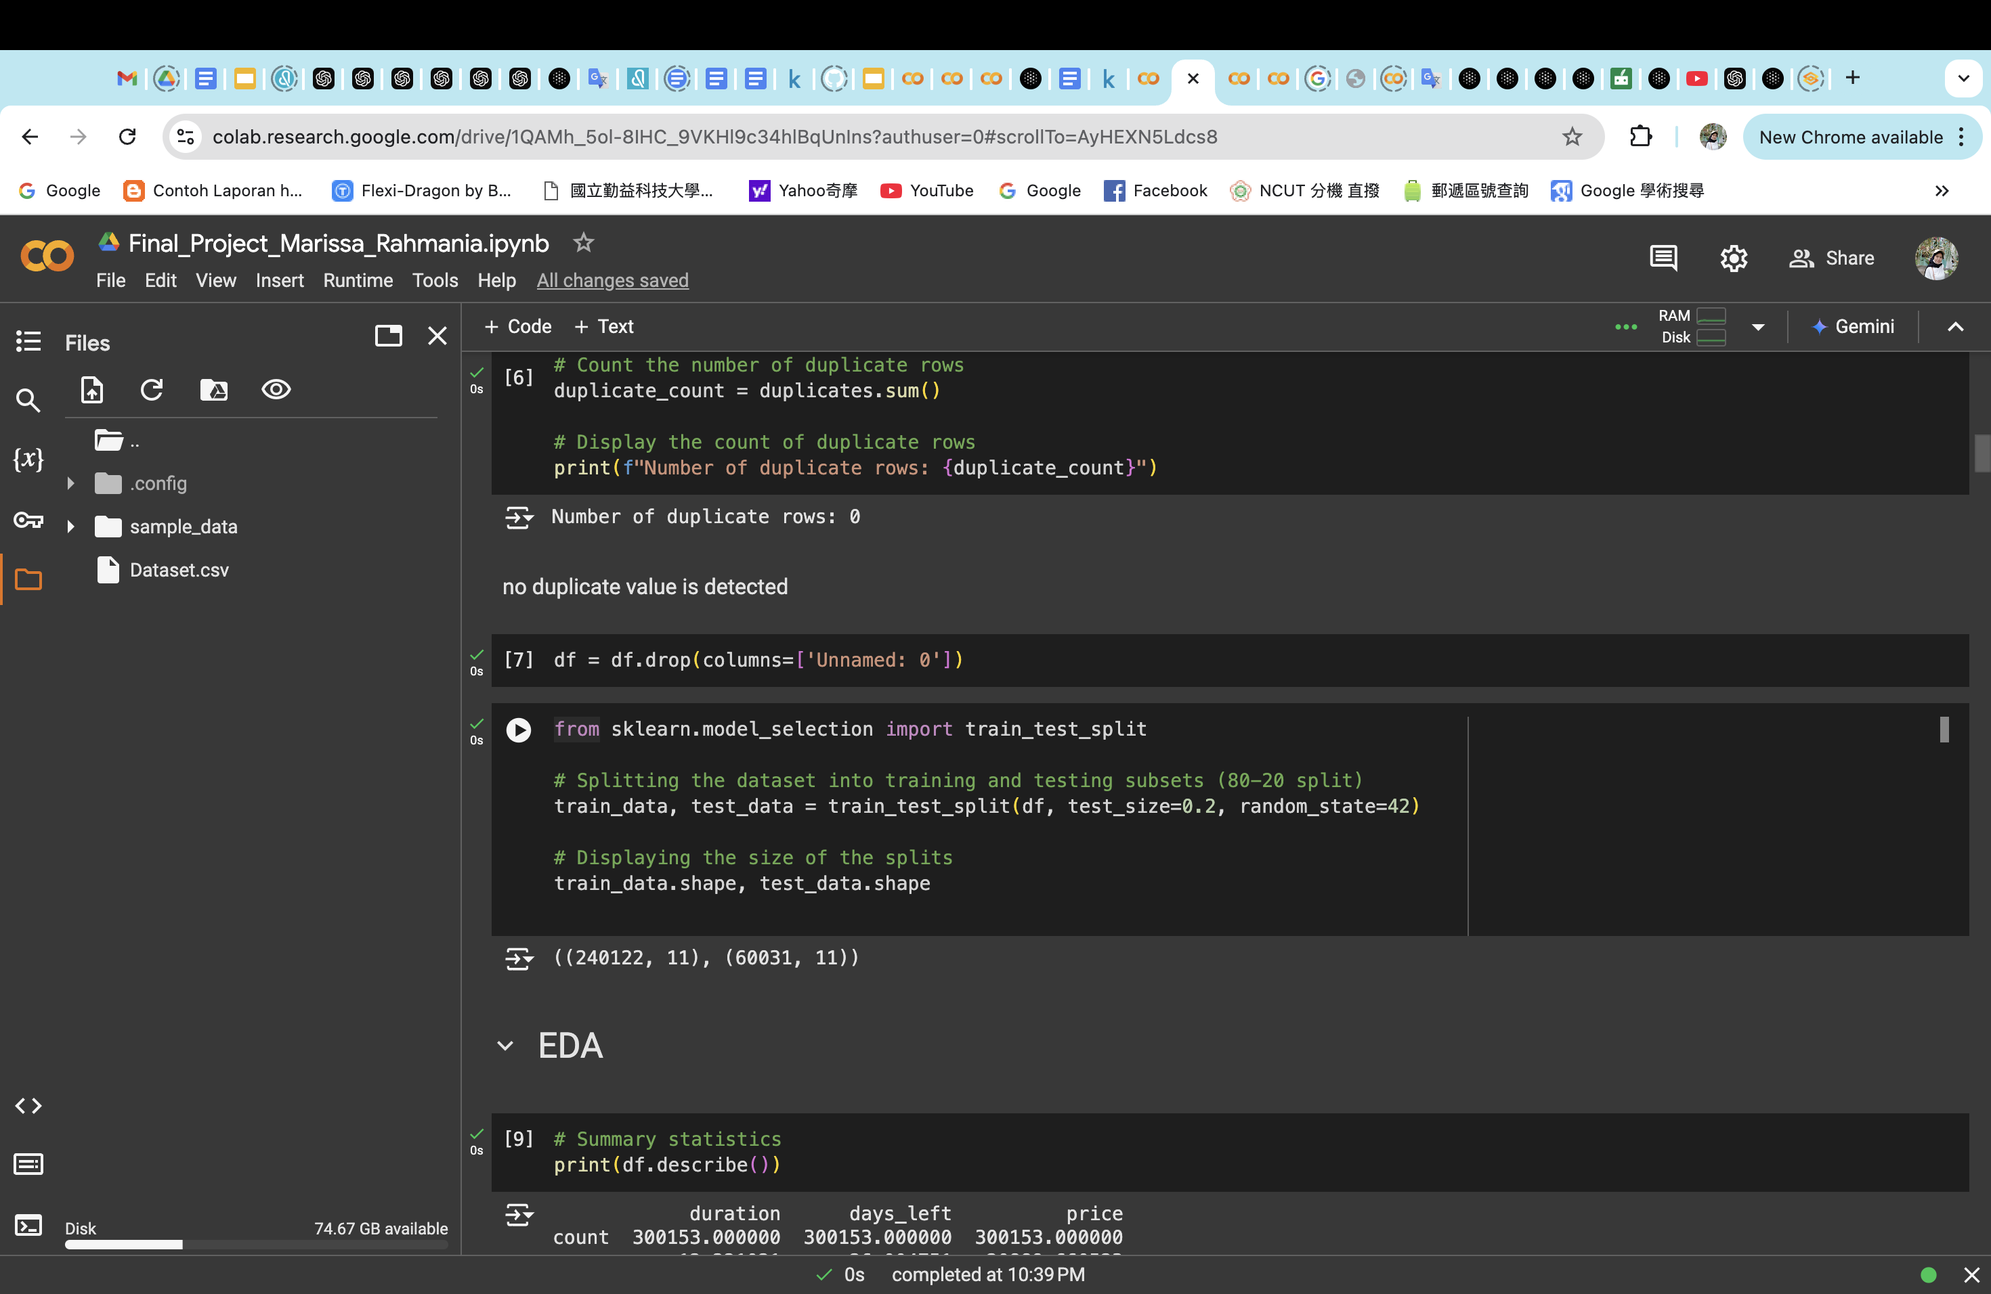
Data Preprocessing
Data is clean; no need for a deep cleaning process

Slide 5
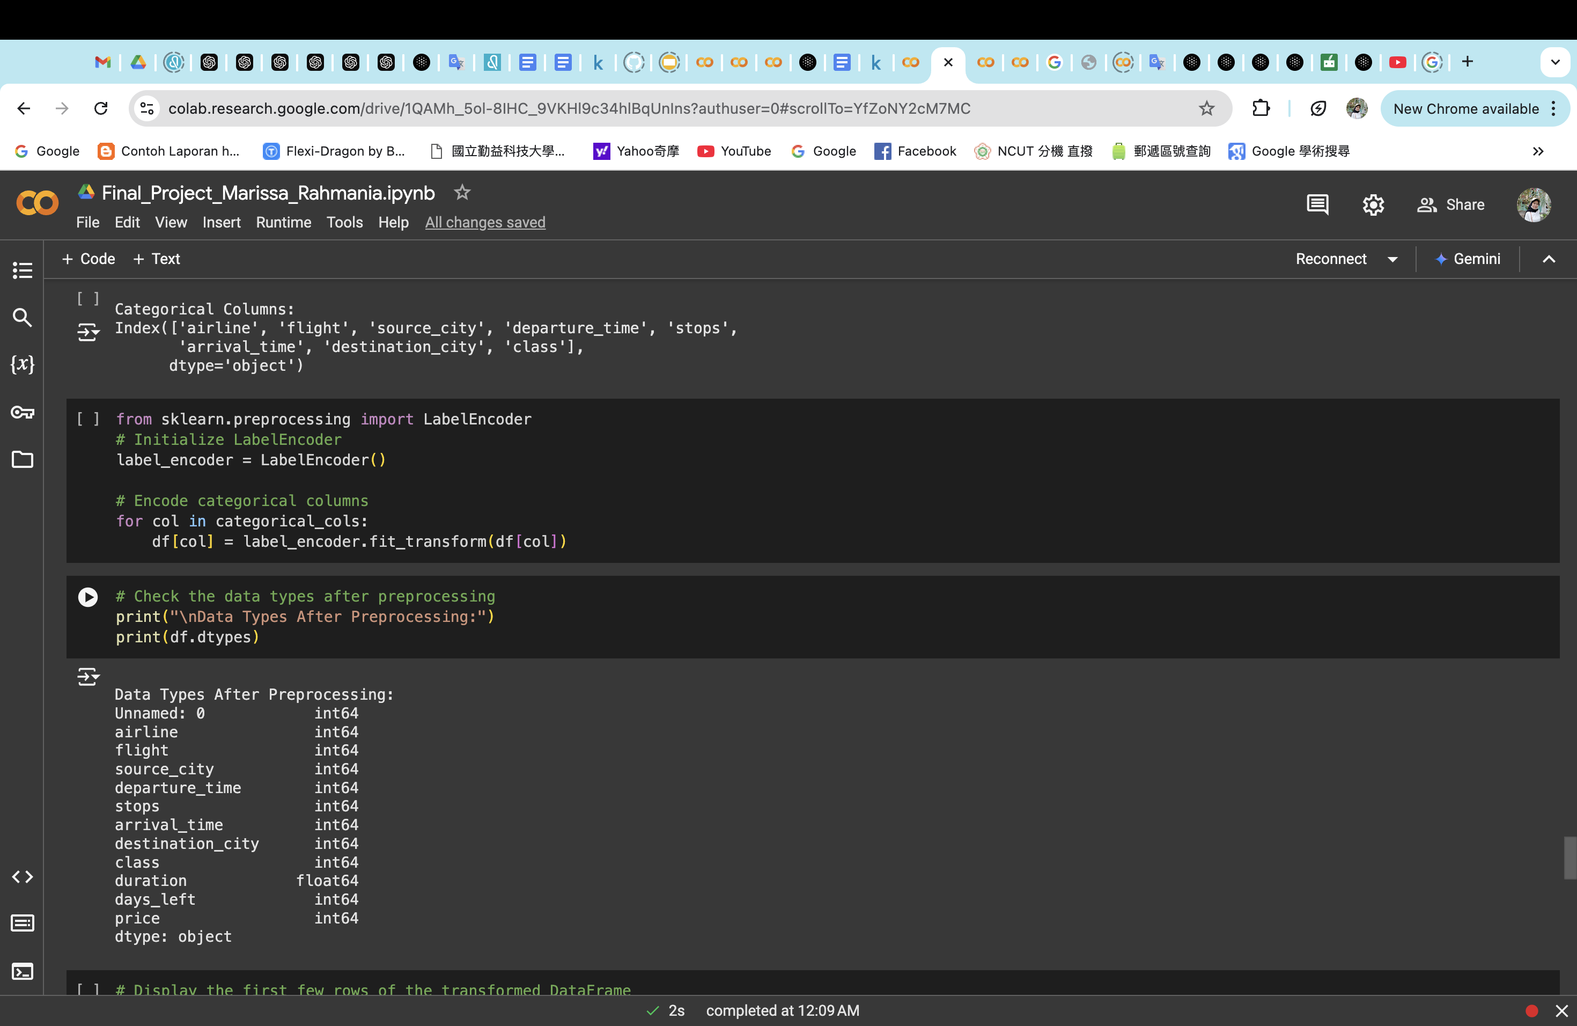
Data Manipulation
Airlines
Stops
AirAsia : 0
Air India : 1
GO_FIRST : 2
Indigo : 3
SpiceJet : 4
Vistara : 5
Two_or_more: 0
One: 1
Zero: 2
Class
Departure Time
Afternoon: 0
Early_Morning: 1
Evening: 2
Late_Night: 3
Morning: 4
Night: 5
Business: 0
Economy: 1

Slide 6
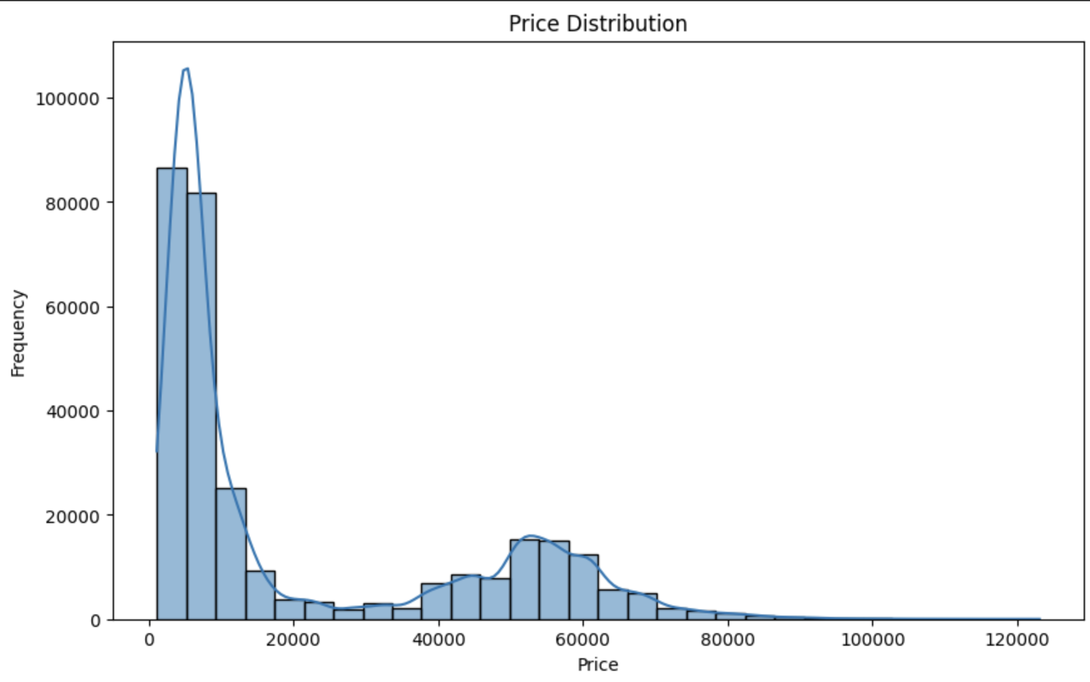
EDA
Most of the ticket prices are around 80000 Rupees.

Slide 7
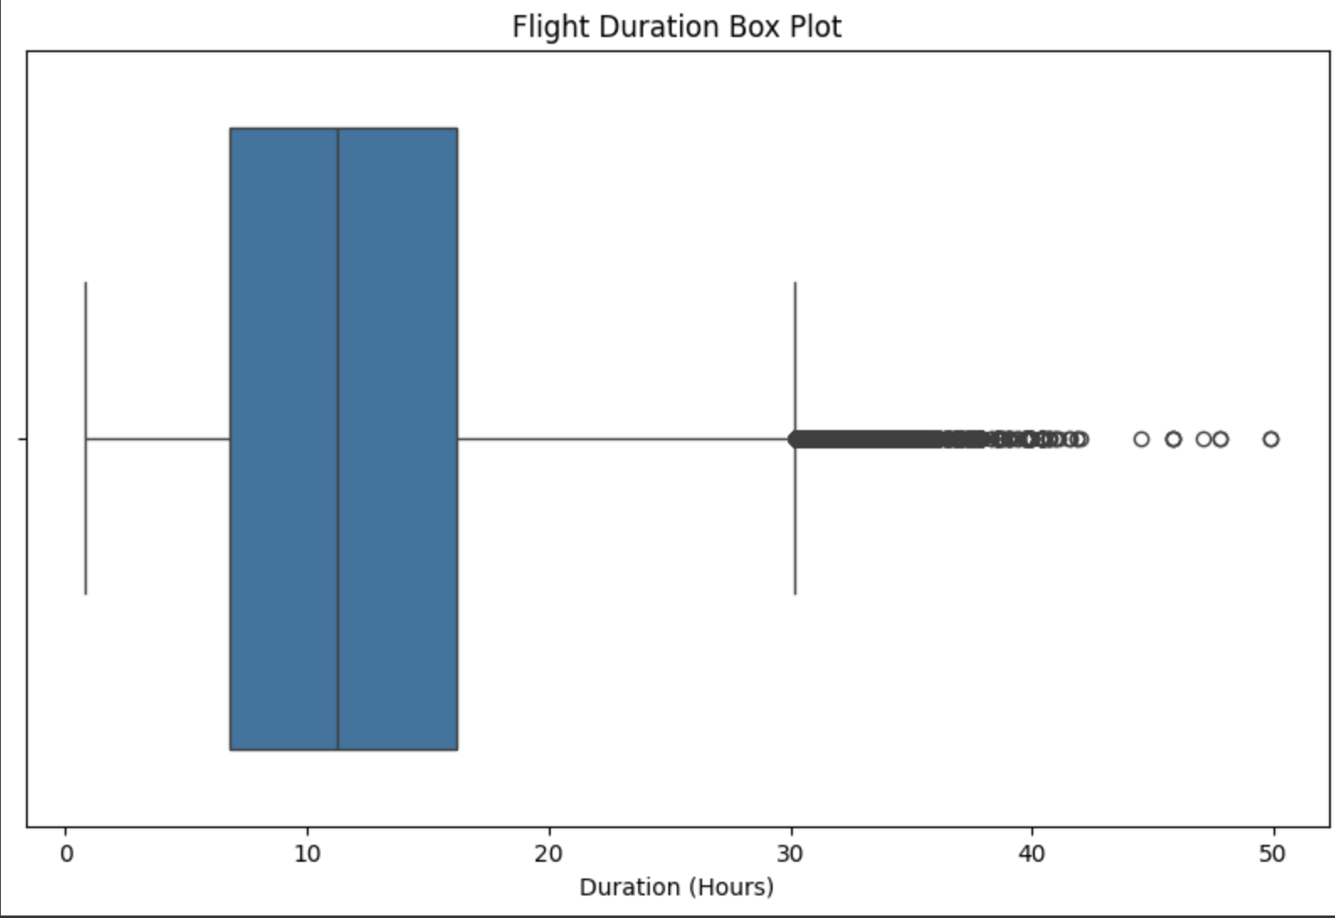
EDA
Most of the flight durations are in the range of more than 5 hours to less than 20 hours.
However, there are some outliers detected in the range of 30 hours to 50 hours.

Slide 8
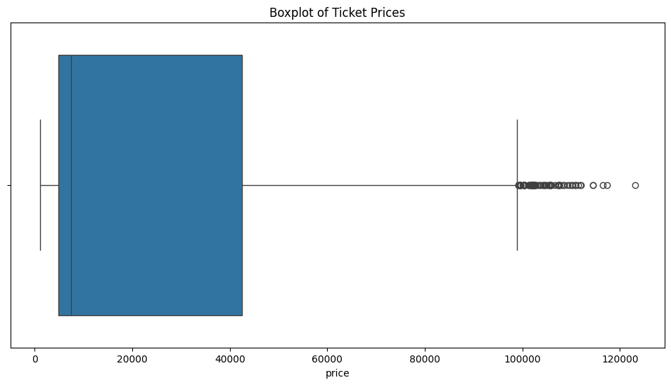
EDA
Approximately 2,399 extreme outliers above the 99th percentile.

Slide 9
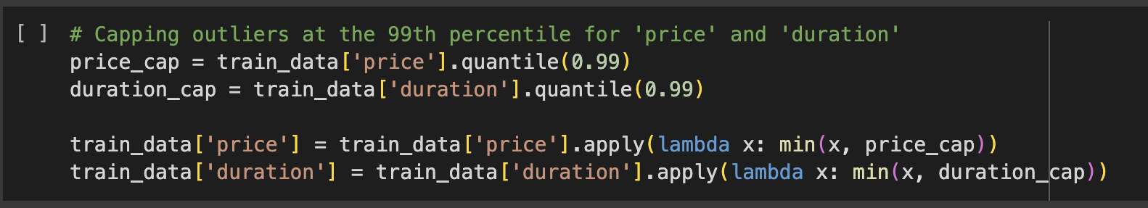
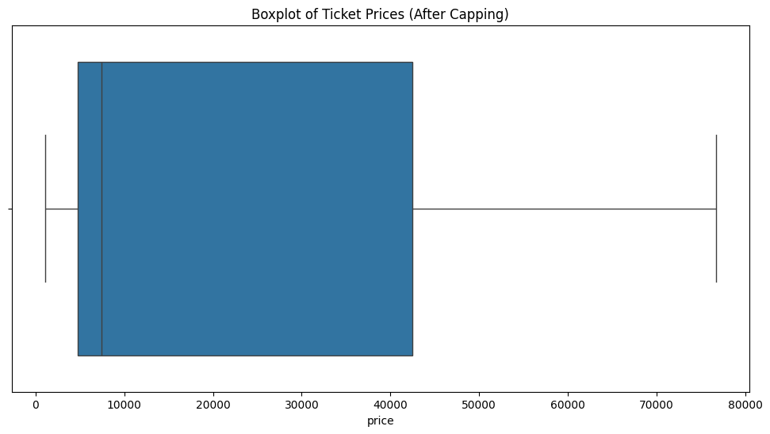
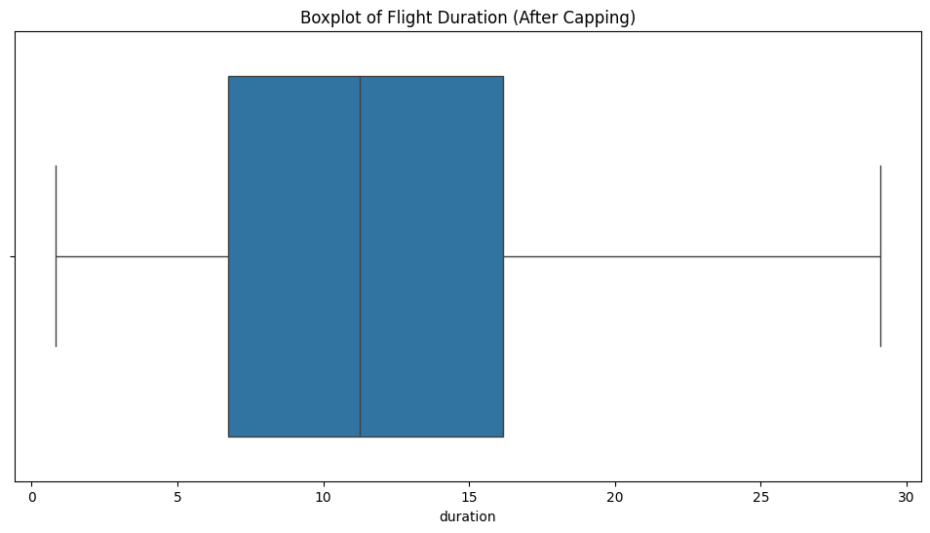
EDA
No more Outliers detected in Ticket Prices and Flight Duration

Slide 10
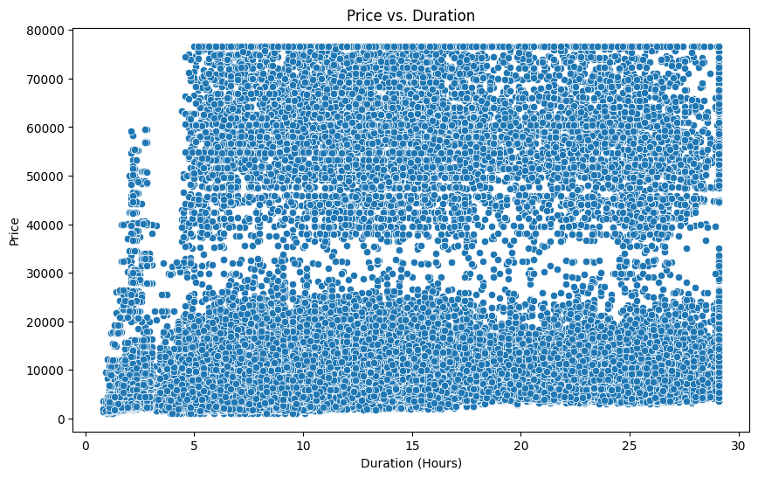
EDA
After capping the Outlier, most of Price and Duration have similar distribution

Slide 11
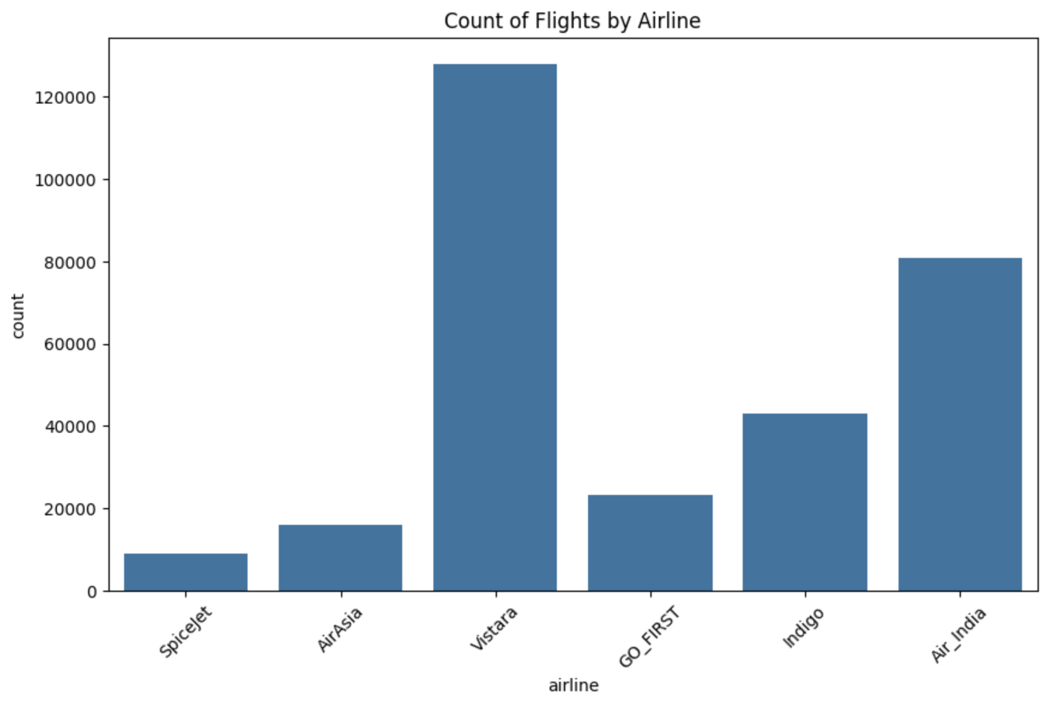
EDA
Airline Vistara has the most flight offers of more than 120,000.
Lastly, SpiceJet has become the lowest one with around 10,000 offers compared to others.

Slide 12
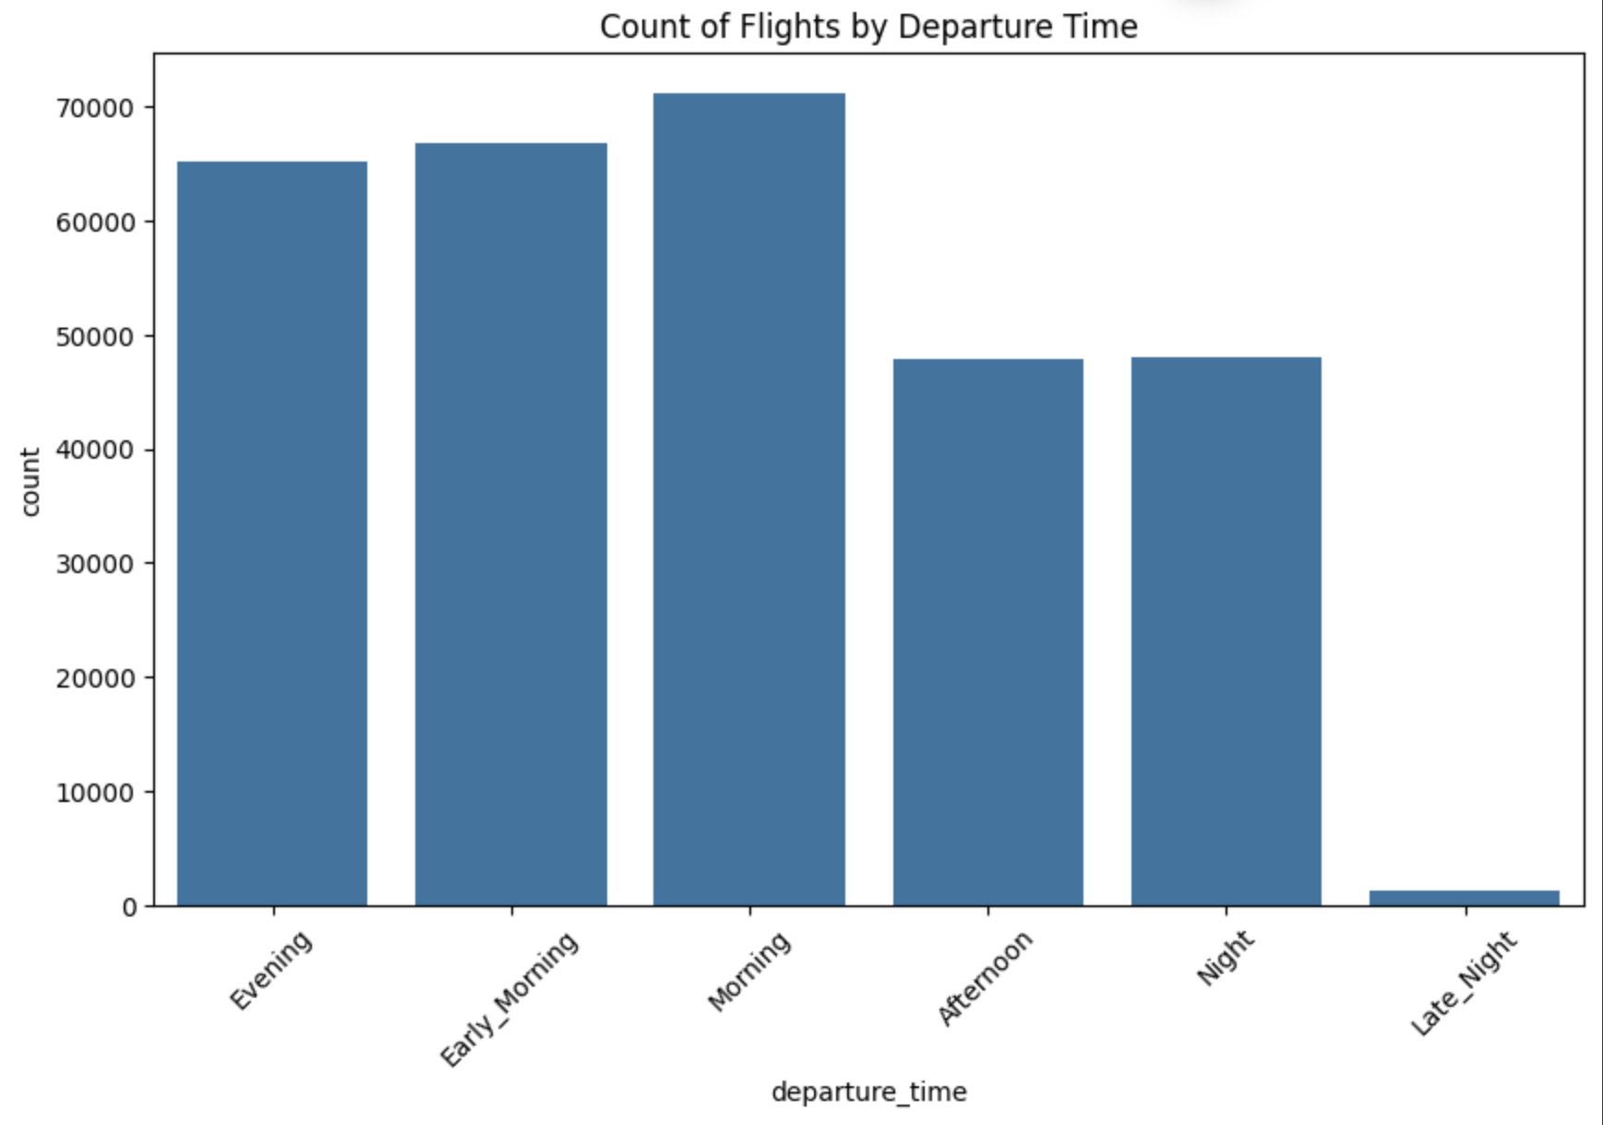
EDA
Most of the flights are in the morning, Early_Morning, Evening, Afternoon, and Night.
Late-night flights are the lowest rate, with around less than 5,000 flights.

Slide 13
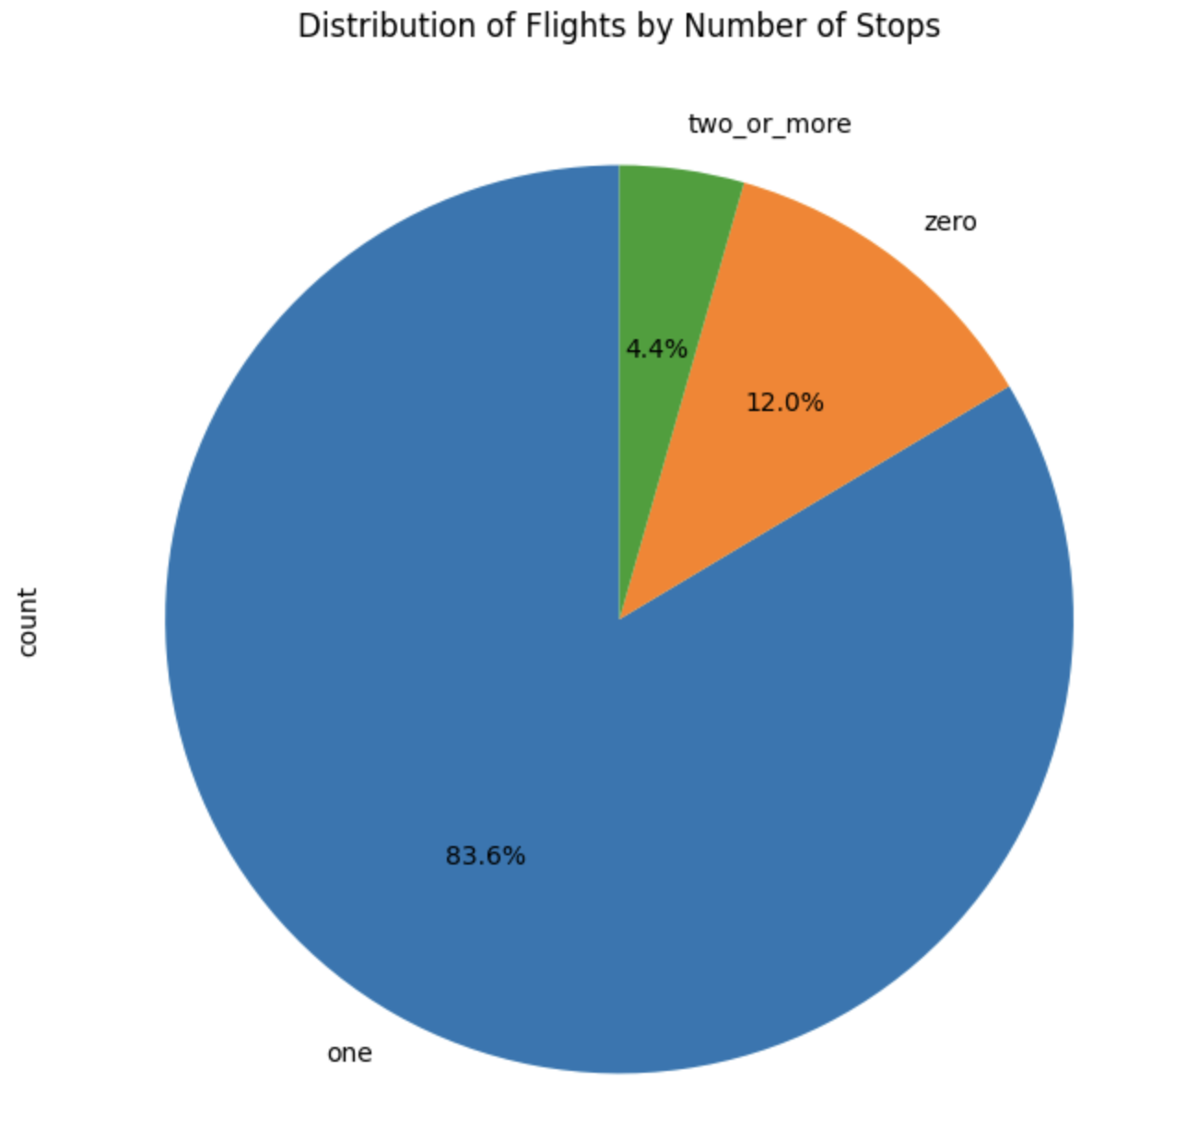
EDA
The highest distribution of flights available is having a one-stop flight.
whereas the rest of the flights are non-stop flights and flights with two or more stops flights, out of all flights available.

Slide 14
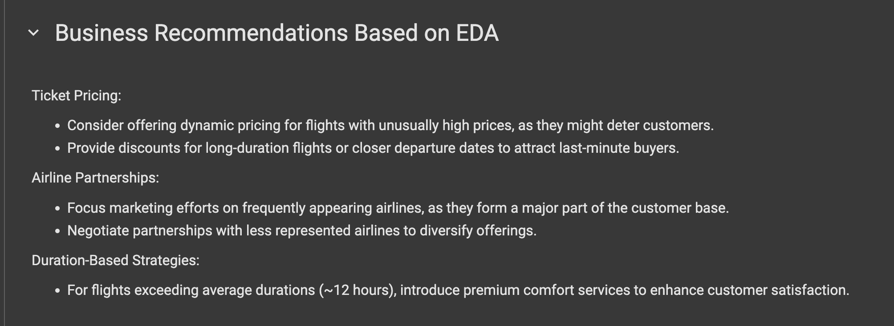
EDA

Slide 15
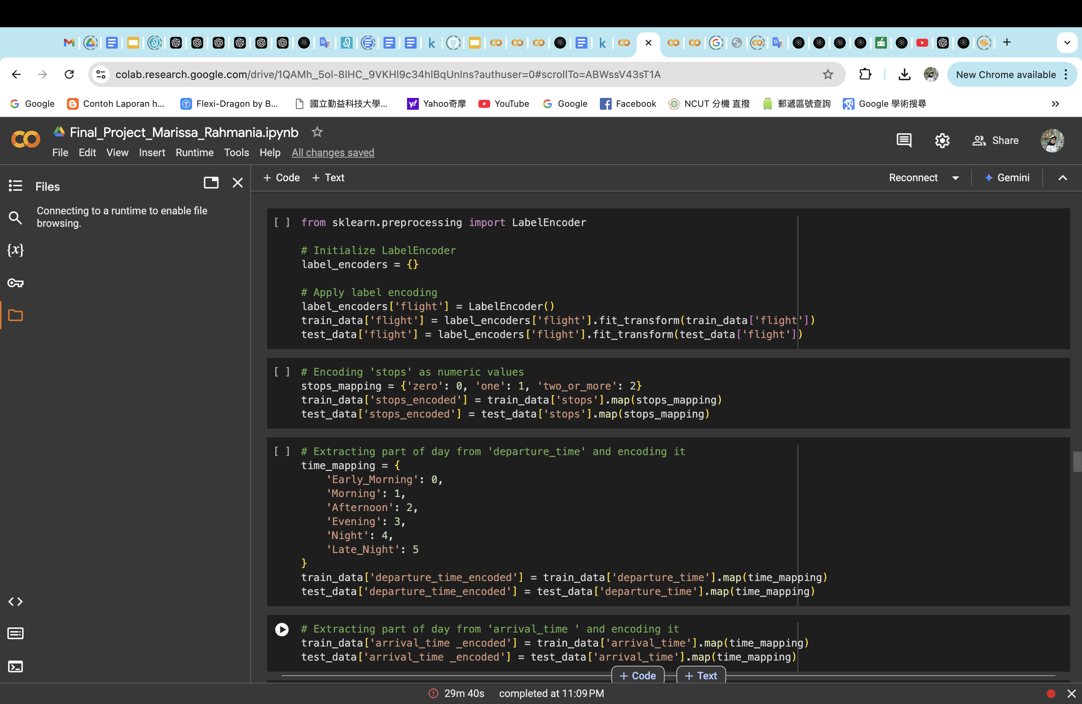
Feature Engineering
Data Manipulation

Slide 16
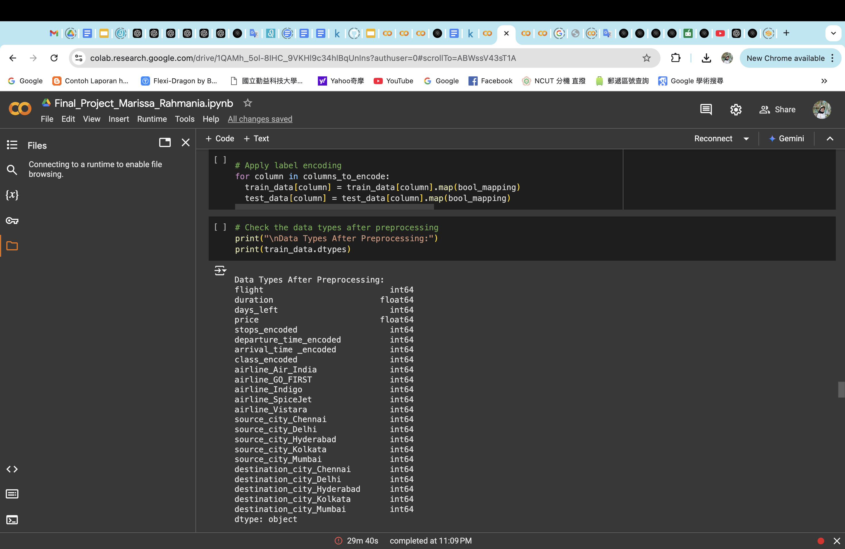
Feature Engineering
Data Manipulation
All Numeric

Slide 17
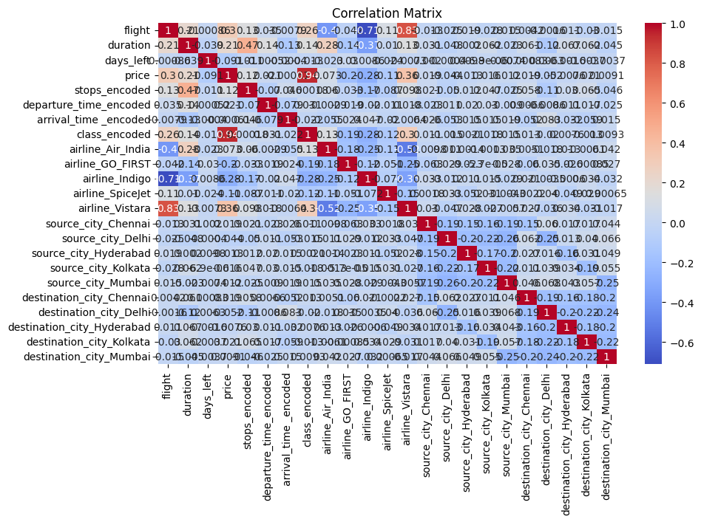
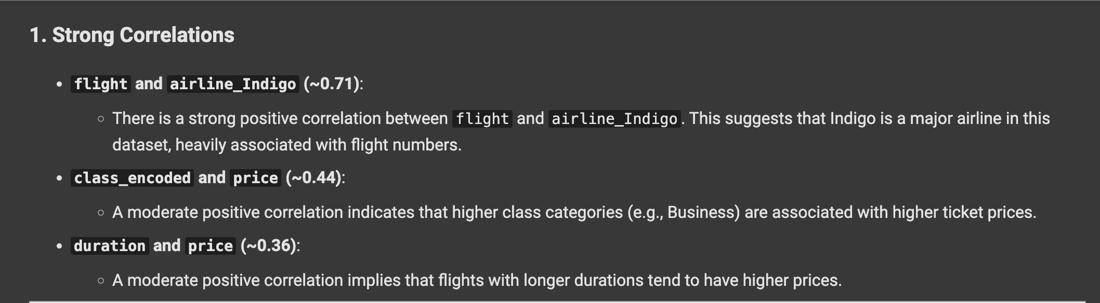
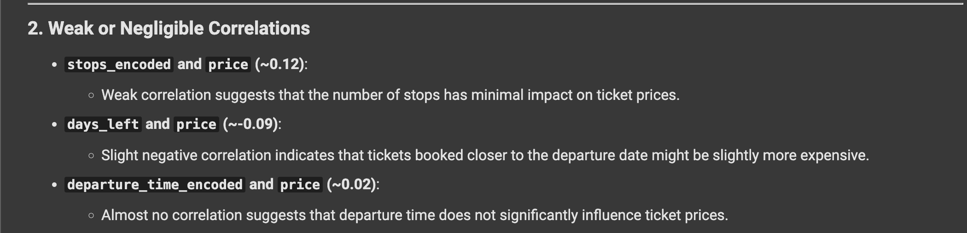
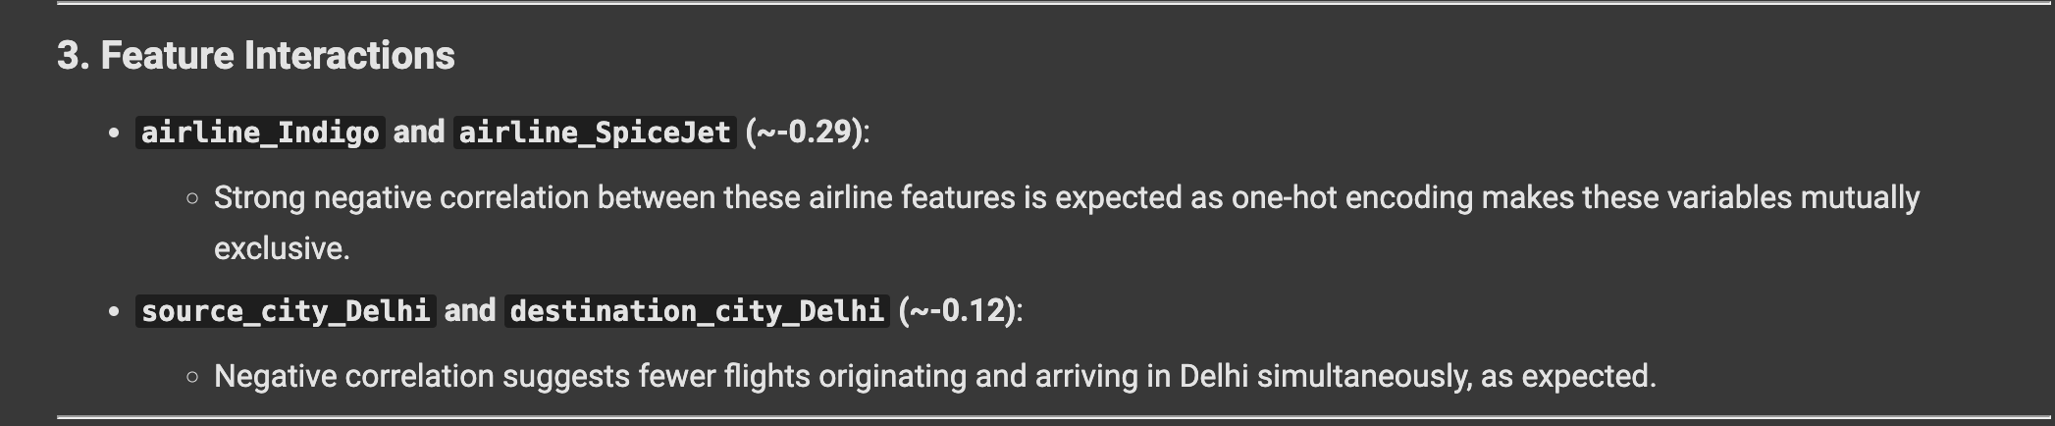
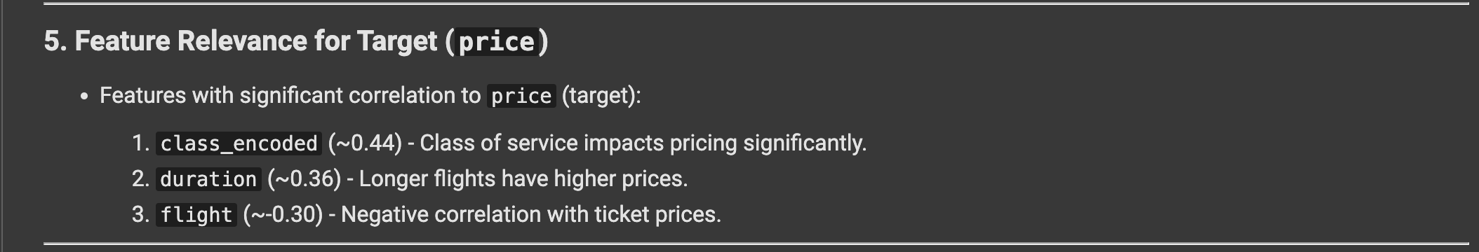
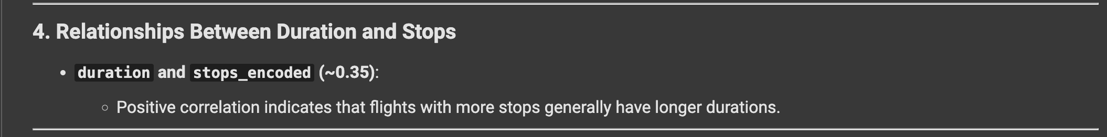
Feature Interpretation

Slide 18
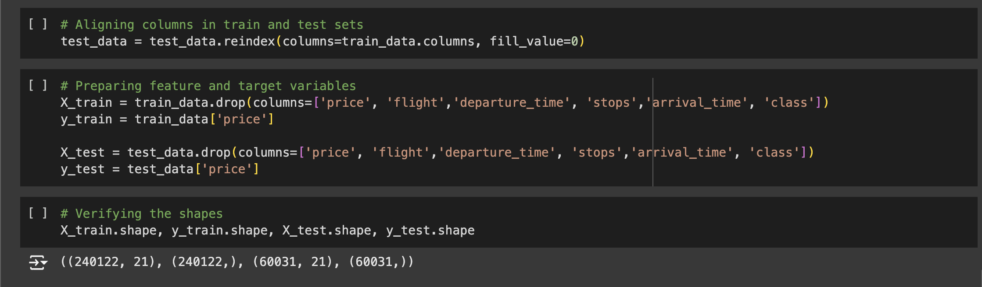
Modelling Machine Learning
Preparation

Slide 19
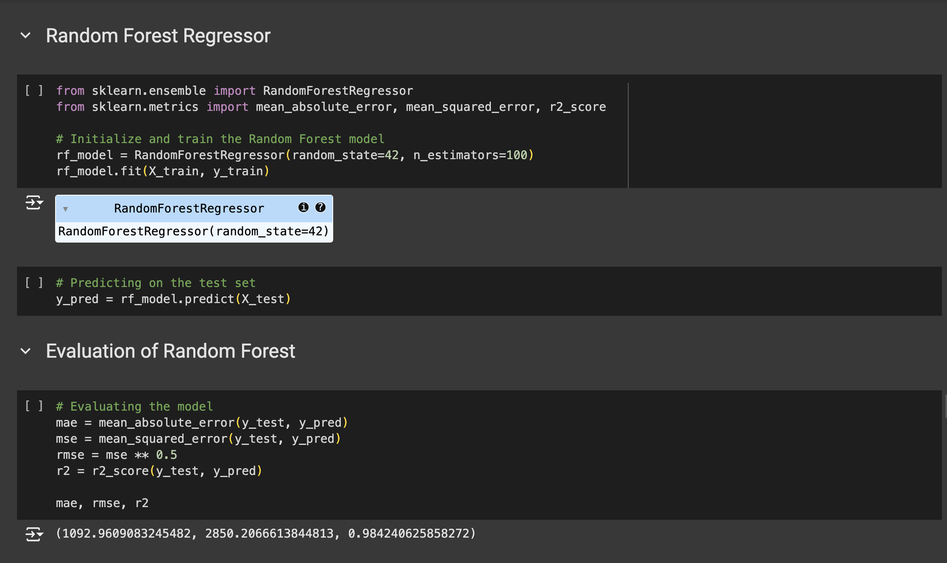
Modelling Machine Learning

Slide 20
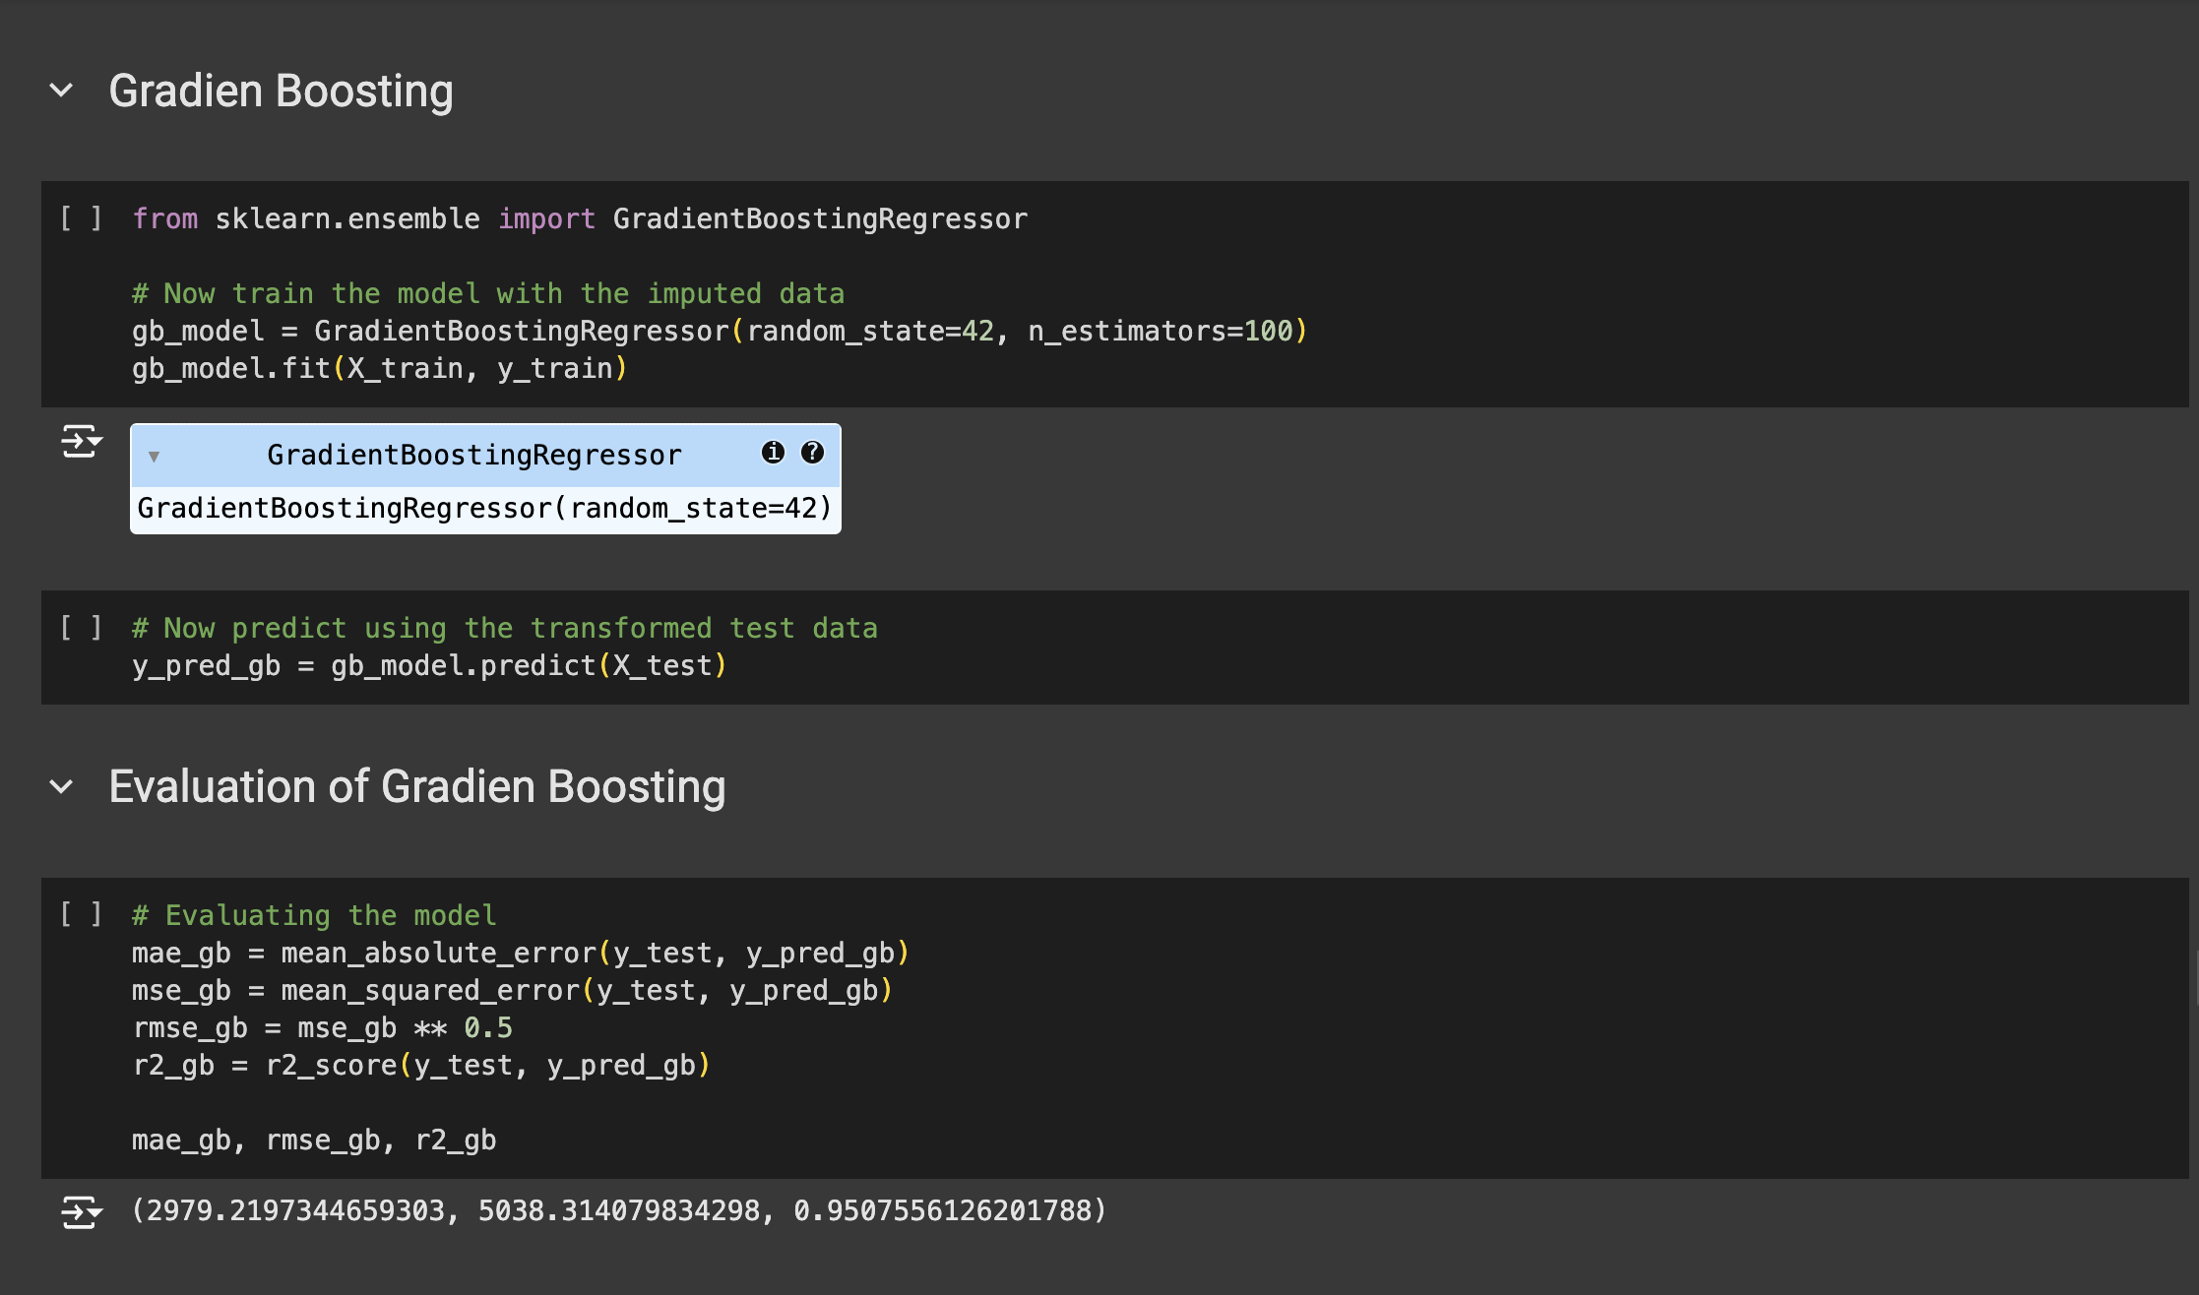
Modelling Machine Learning

Slide 21
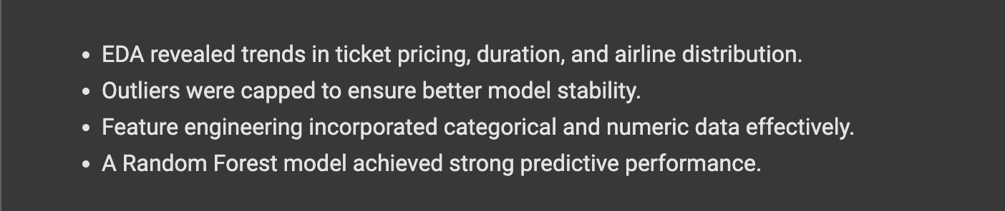
Summary
Model | MAE | RSME | R2
Random Forest Regression | 10.92% | 28.5% | 98.42%
Gradient Boosting Regression | 29.79% | 50.38% | 95.07%

Slide 22
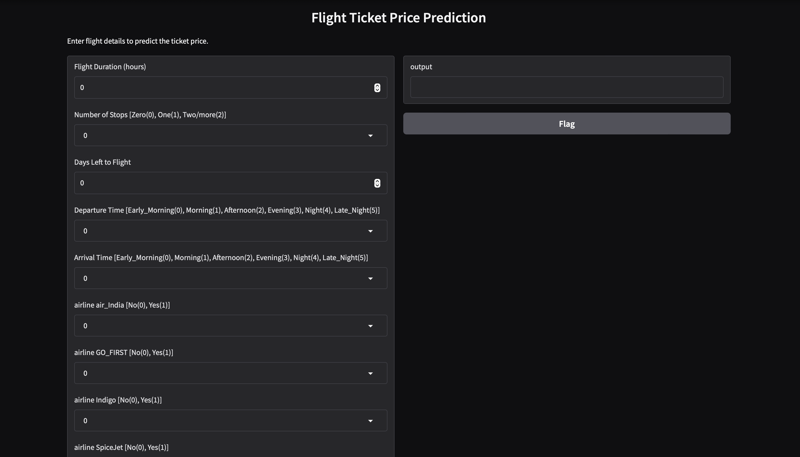
Model Deployment
Gradio – User Interface
http://127.0.0.1:7860

Slide 23
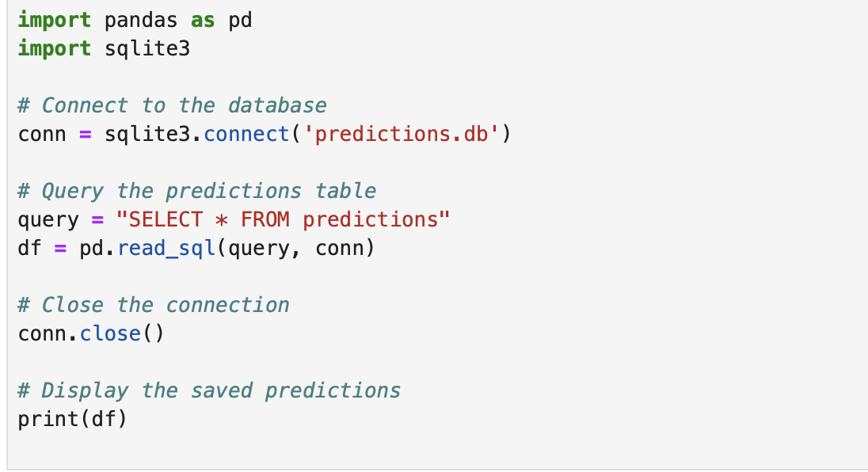
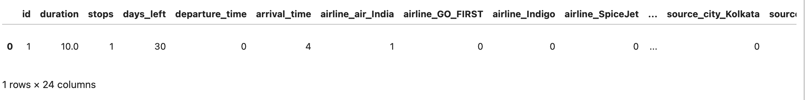
Log Prediction model
Real time Prediction:
http://127.0.0.1:7860
Save Prediction Result into Database:

Slide 24
Thank You

